Slide 1

TEAM MEMBERS
MEMBERS OF TEAM AURORA
TEAM AURORA
“None of us is as smart as all of us”
Gowtham.R- gowtham.raghavan@aspiresystems.biz
Manimaran.V – manimaran.venkat@aspiresystems.biz
Girishkumar .R– girish.ravi@aspiresystems.biz
Ponvizhi .U- ponvizhi.uday@aspiresystems.biz
Venkateshwaran.M – venkatesh.malai@aspiresystems.biz
Sandhya.S – sandhiya.sakthivel@aspiresystems.biz
Pooja.S – pooja.Sakthivel@aspiresystems.biz
Ranjith.R – Ranjith.ramasamy@aspiresystems.biz
Sriram.M– sriram.manis@aspiresystems.biz
Mohammed Irfan.S - irfan.sadiq@aspiresystems.biz
Web Request Life Cycle

Slide 2
Web Request
A web request is a communicative message that is transmitted between the client, or web browsers, to the servers. This request is essential in providing the user with the correct and preferred webpages that the server will then display on the user's interface.

Slide 3
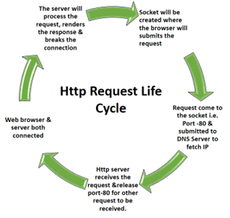

Slide 4
A user types the URL
The browser sends the request and specifications to the server
The server interprets the request, using a route handling function to interact with the database, form the response data, and set the response status
The server sends the response. Something along the lines of 200OK, 304 Created, 401 Unauthorized, or 500 Internal Server Error. These are just some examples of the HTTP response codes that you will be exposed to
Browser Interprets Response and displays data from the server to the client

Slide 5
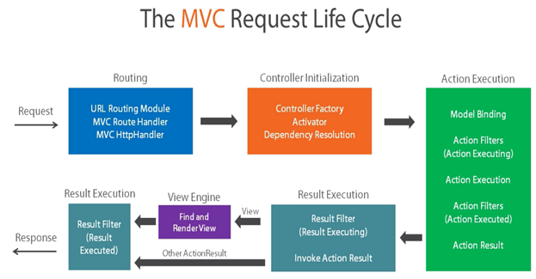

Slide 6


